Slide 1
Research & Development Group
Is Water Viable Energy Resource?
Renewable Energy Feasibility Study
Prepared By: Ryan Downer

Slide 2
AGENDA
Introduction
Energy Resources

Slide 3
Renewable Energy Sources

Slide 4
Energy Resources

Slide 5
Renewable vs Non-Renewable Sources

Slide 6
The Ultimate Renewable Energy Source?
Abundance
Easily availiable and accessible
Efficient
Environmentally Friendly

Slide 7
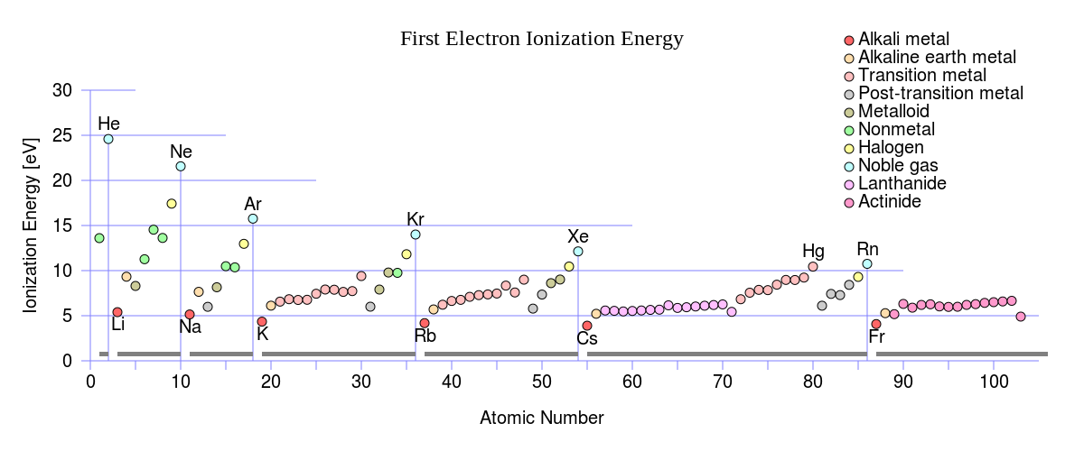
First Ionization Energy Animosity

Slide 8
HYDRO-OXY Cycle
$$Water \\ \left[{ H}_{2}O\right]$$
𝐖𝐚𝐭𝐞𝐫 [〖 𝑯〗_𝟐 𝑶]
$$HHO \\ \left[2{ H}_{2}\text{ + }O_{2}\right]$$
𝑯𝑯𝑶 [𝟐〖 𝑯〗_𝟐 " + " 𝑶_𝟐 ]
Industrial Processes
Combustion
Re-Combination
Aluminium Reduction
Water Hydrolysis
High Purity Water
Fuel Cell
Hydro-Carbon/Ammonia Reformation
Distilled
De-Ionized
HV Disassociation
Hydro-Oxy Gas
Browns Gas
HHO Gas
Stoichiometrically Balanced

Slide 9
Fuel Cell Basics

Slide 10
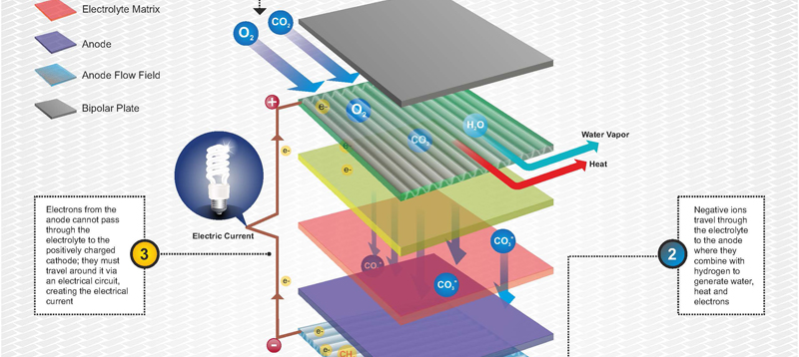
How Direct Fuel Cell Works

Slide 11
FuelCell Energy 1.4 MEGAWATTS FC1500 Plant
Technical Specifications

Slide 12
FuelCell Energy
1.4 MEGAWATTS FC1500 Plant

Slide 13
1.4 MEGAWATTS FC1500 Plant KEY FEATURES:
ADVANTAGES
The DFC1500™ stationary fuel cell power plant from FuelCell Energy provides high-quality, Ultra-Clean electrical power with 47% efficiency around-the-clock. Designed for commercial and industrial applications, the system offers easy transport, quiet and reliable operation, and simple site planning and regulatory approval. The DFC1500 is ideal for wastewater treatment plants, manufacturing, food and beverage processing, universities and office campuses.
High Efficiency
Low Environmental Impact
Fuel Flexibility
High Reliability
Quiet Operation

Slide 14
PERFORMANCE COMPARISON: Gross Power Output
Gross Power Output | DFC300 | DFC1500 | DFC3000
Power @ Plant Rating |  | 1,400 kW
Standard Output AC voltage |  | 480 V
Standard Frequency |  | 60 Hz
Optional Output AC Voltages |  | By Request
Optional Output Frequency |  | 50 Hz
Efficiency (LHV) |  | 47 +/- 2 %

Slide 15
PERFORMANCE COMPARISON (Con’ted): Available Heat
Available Heat | DFC300 | DFC1500 | DFC3000
Exhaust Temperature |  | 700 +/- 50 ºF
Exhaust Flow |  | 18,300 lb/h
Allowable Backpressure |  | 5 iwc
Heat Energy Available for Recovery
(to 250 ºF) |  | 2,216,000 Btu/h
(to 120 ºF) |  | 3,730,000 Btu/h

Slide 16
[Section Heading]

Slide 17
THE END
Thank You!

